Slide 1
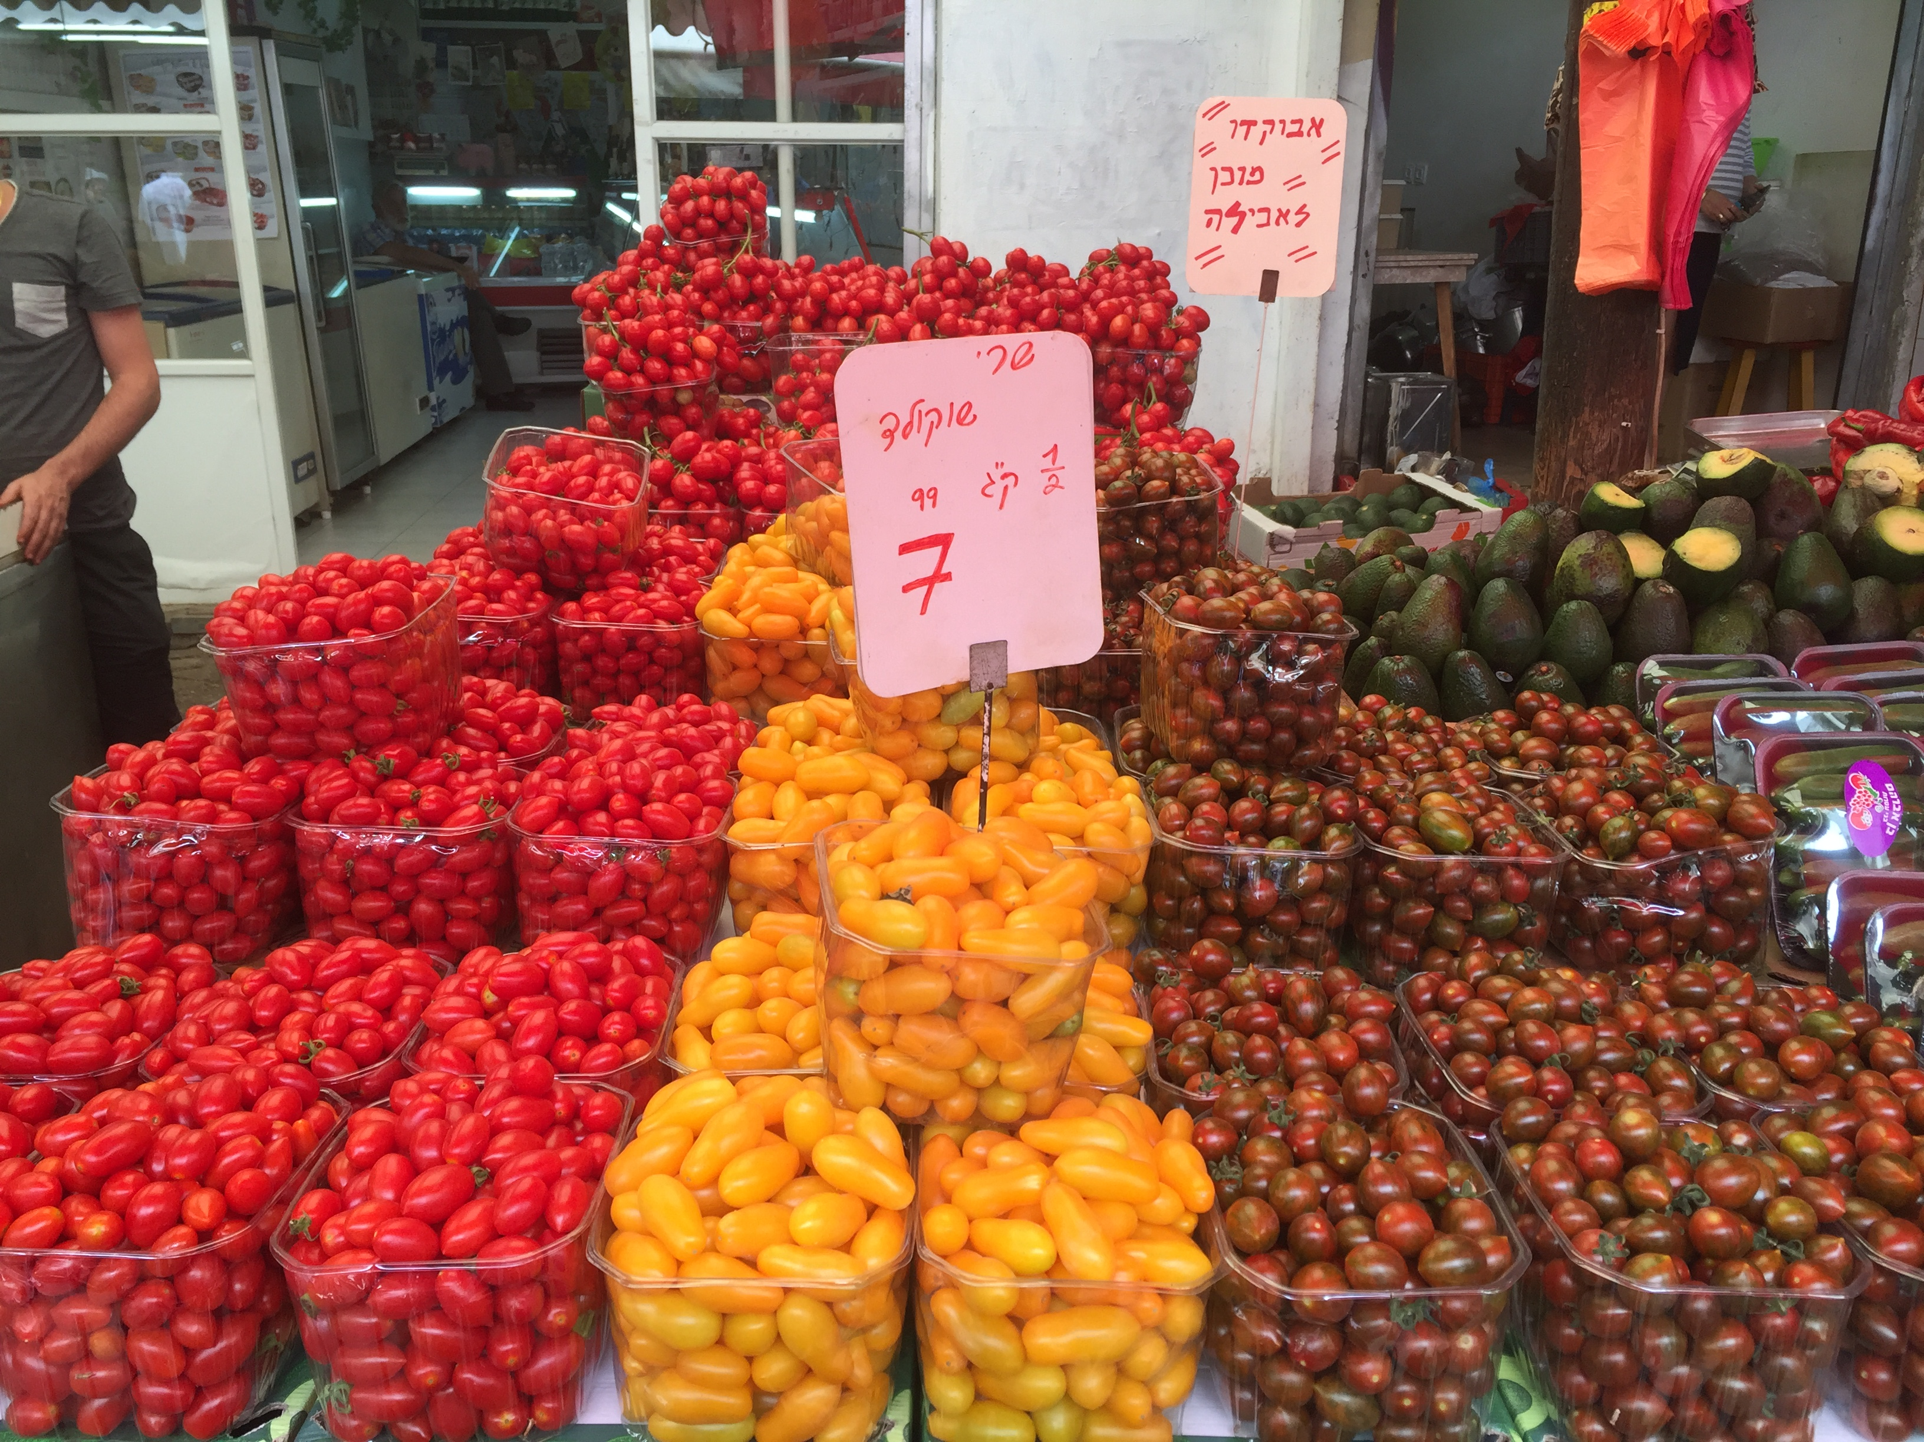

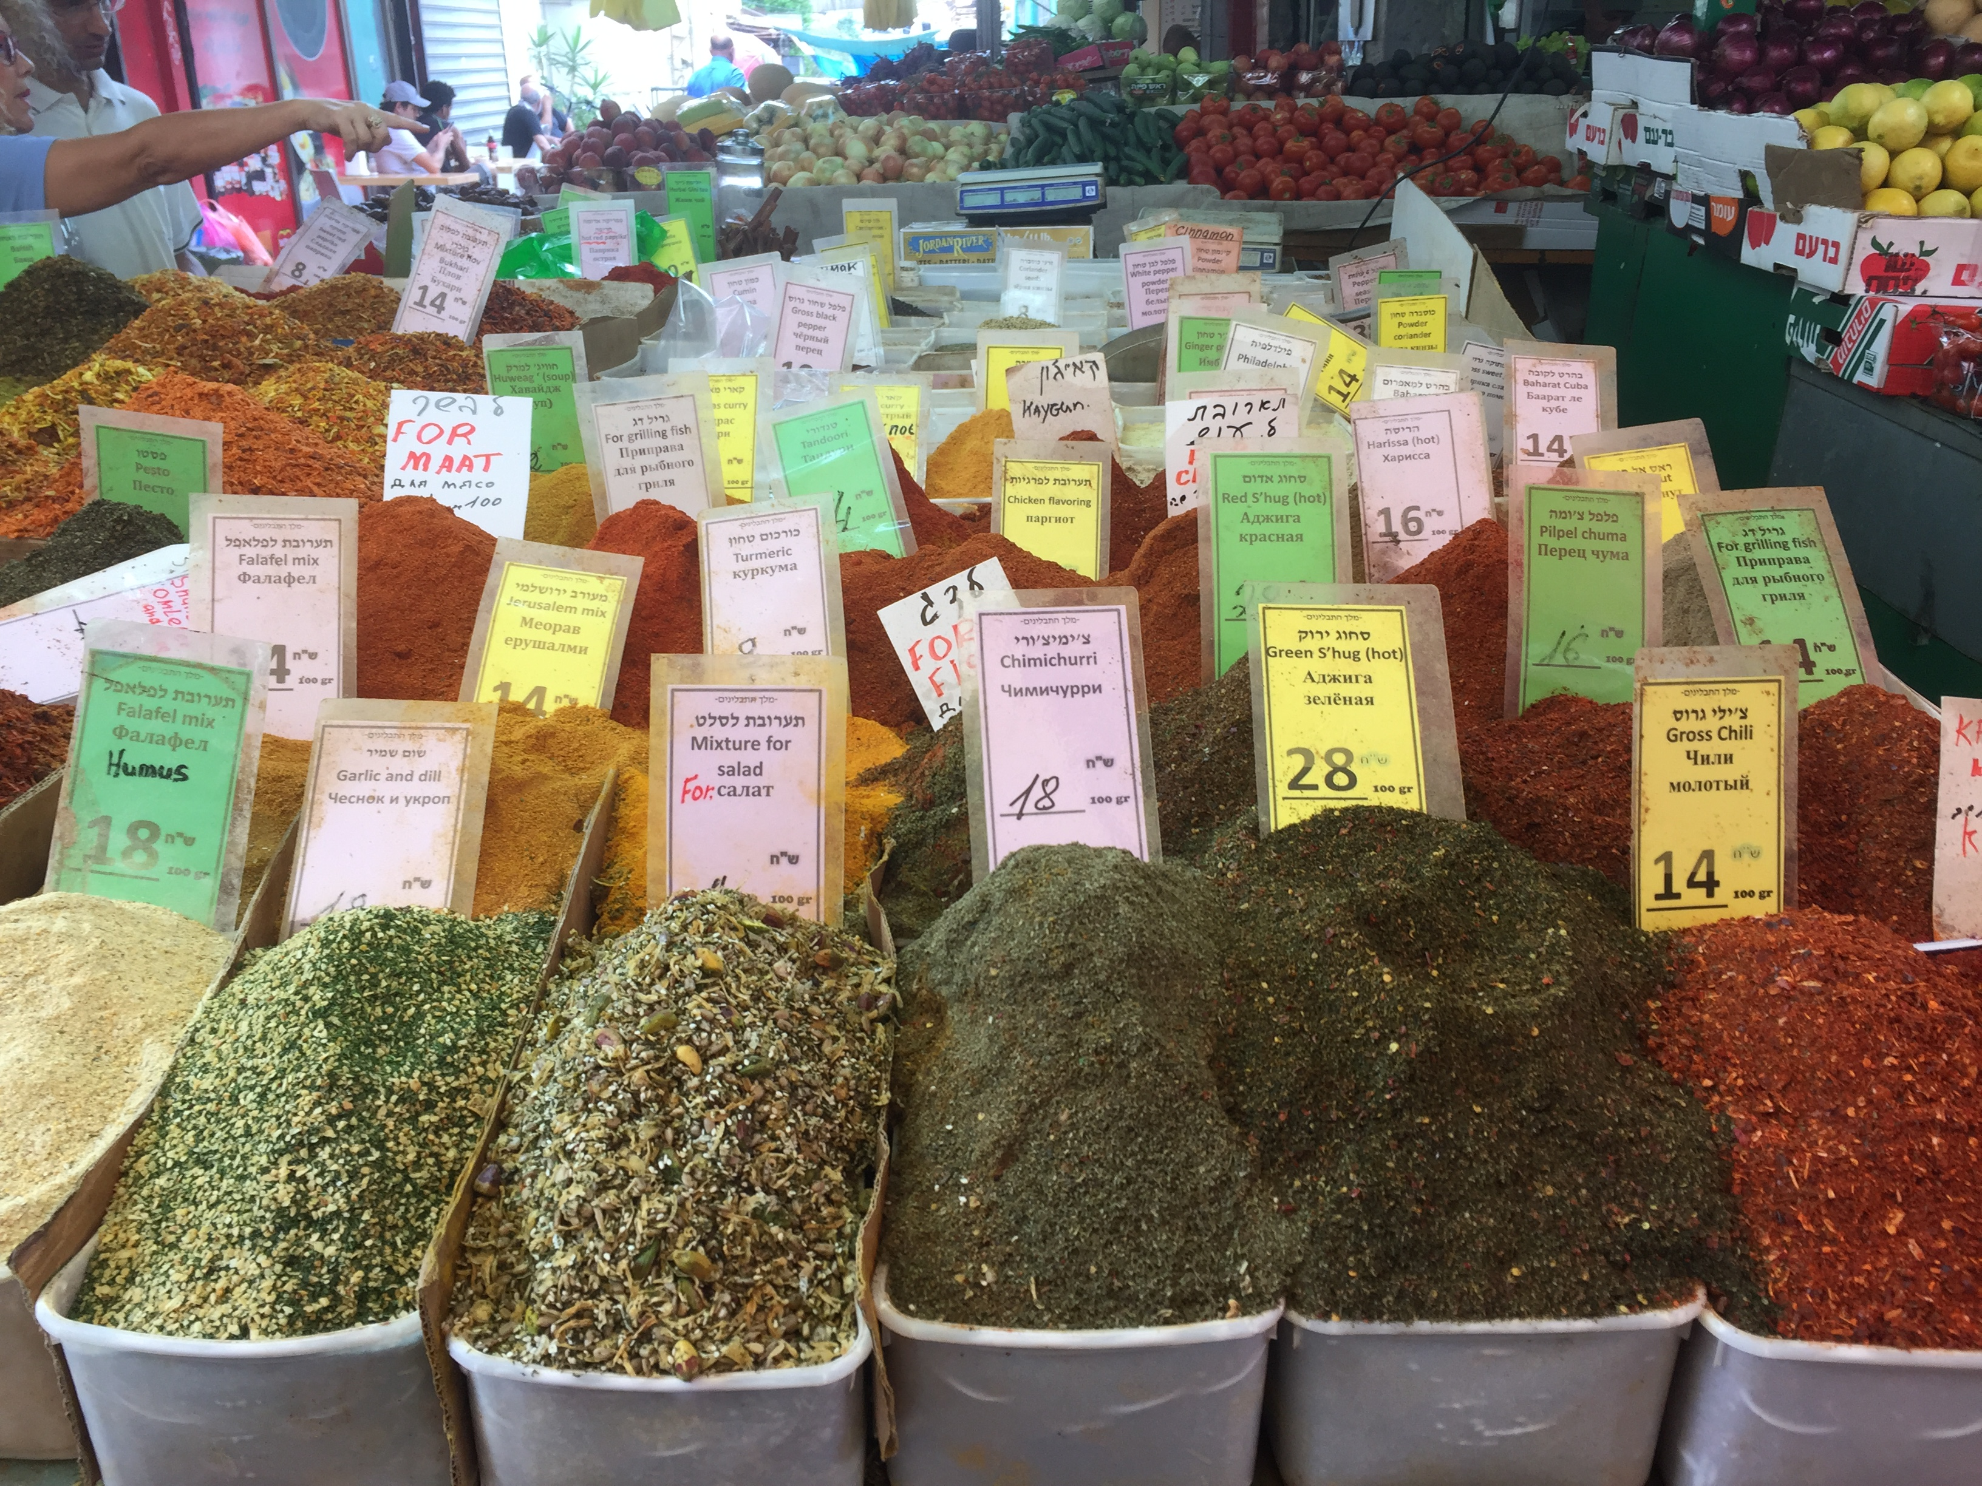








We are what we eat – insights from nutrigenomics research to understand how diet is shaping our health
Michael Müller Professor of Nutrigenomics & Systems Nutrition
@nutrigenomics

Slide 2

You can not change your genes but…. You are what you eat, have eaten, host & how you lived
2 Meals/day, work as long as possible & embrace challenges
Walter Breuning (1896 – 2011, aged 114 years, 205 days)
(But Breuning was also a lifelong cigar smoker, but quit in 1999 when he was 103 because it became too expensive)

Slide 3

Can we blame our genes? Genes + Nutrition => Phenotype
It is not that easy!

Slide 4
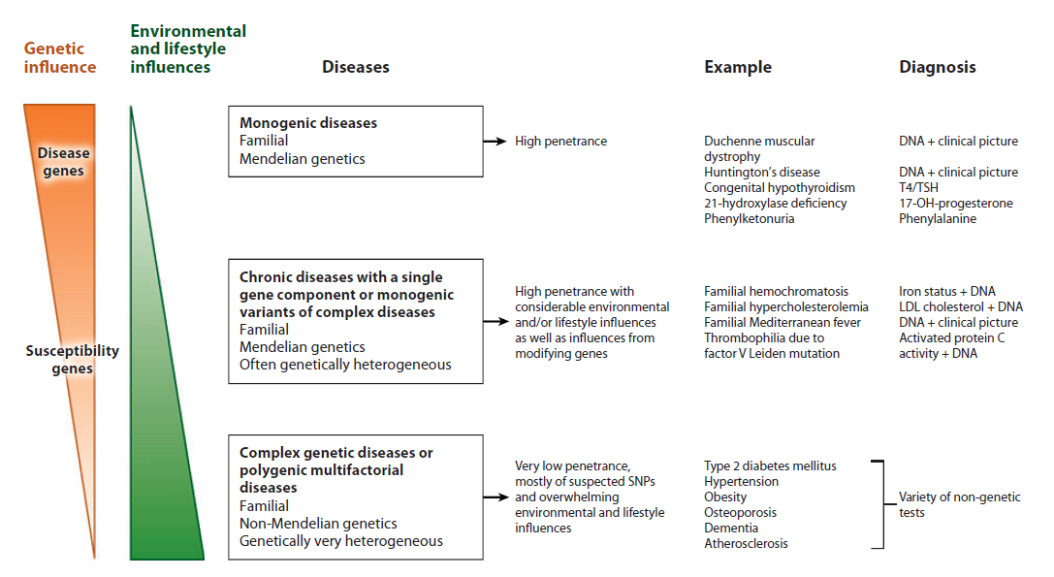
“Our genes are not our destiny” Huge impact of environment and lifestyle on complex genetic diseases
The impact for ‘genetics’ becomes much stronger if we consider next to our
genome also our epi-genomes and the microbial, viral or eukaryotic genomes

Slide 5
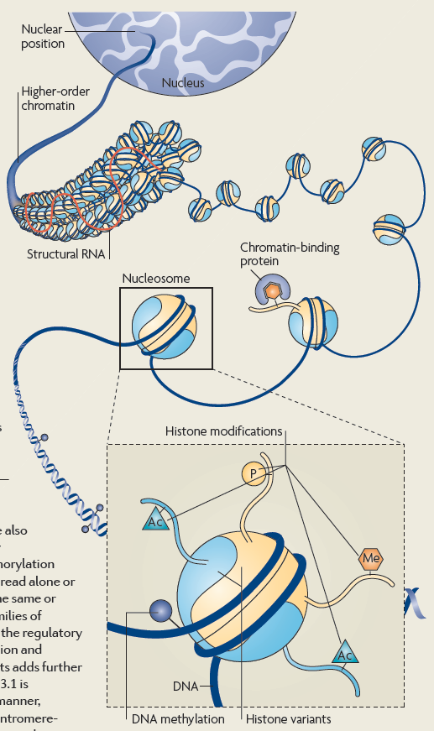
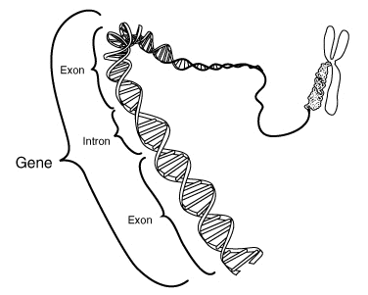
Our genes
23 chromosomes
≈ 20,000+ genes

Slide 6
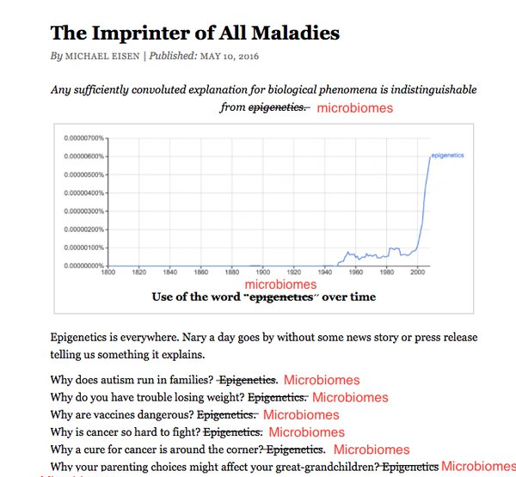
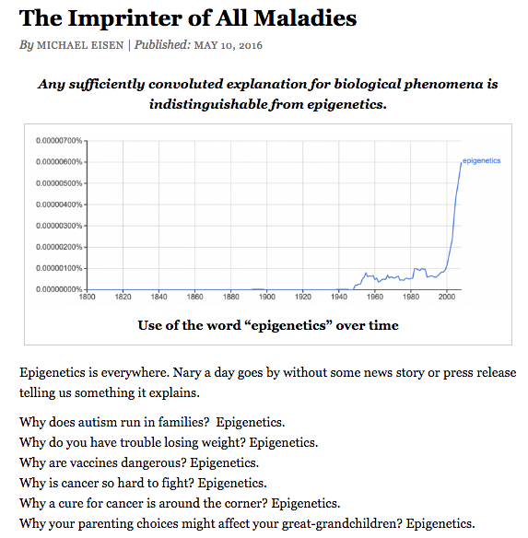
The mechanisms that explain everything
Nutrition / Nutrigenomics

Slide 7
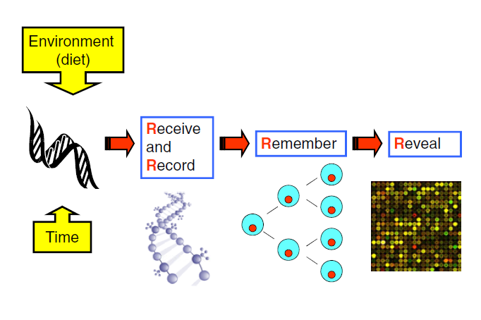
“We are what we eat, have eaten and what we host” 4Rs: Received, Recorded, Remembered & Revealed

Slide 8





“You are what you eat, have eaten & host”

Slide 9
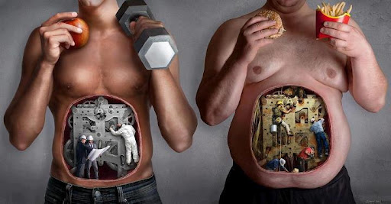

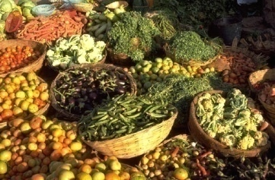
Our “paleolithic” ‘hunter-gatherer’ genes + modern diets
Paleolithic era
Modern Times
1.200.000 Generations between feast en famine
3-4 Generations in energy abundance
% Energy
% Energy
100
100
Grain
Milk/-products
Isolated Carbs
Isolated Fat/Oil Alcohol
Low-fat meat Chicken
Eggs
Fish
50
50
Meat
Chicken
Fish
Fruits
Vegetables (carrots)
Nuts
Honey
Fruits
Vegetables
Beans
0
0
Real Foods with ‘challenges’
“Safe, processed” foods = Less challenges

Slide 10
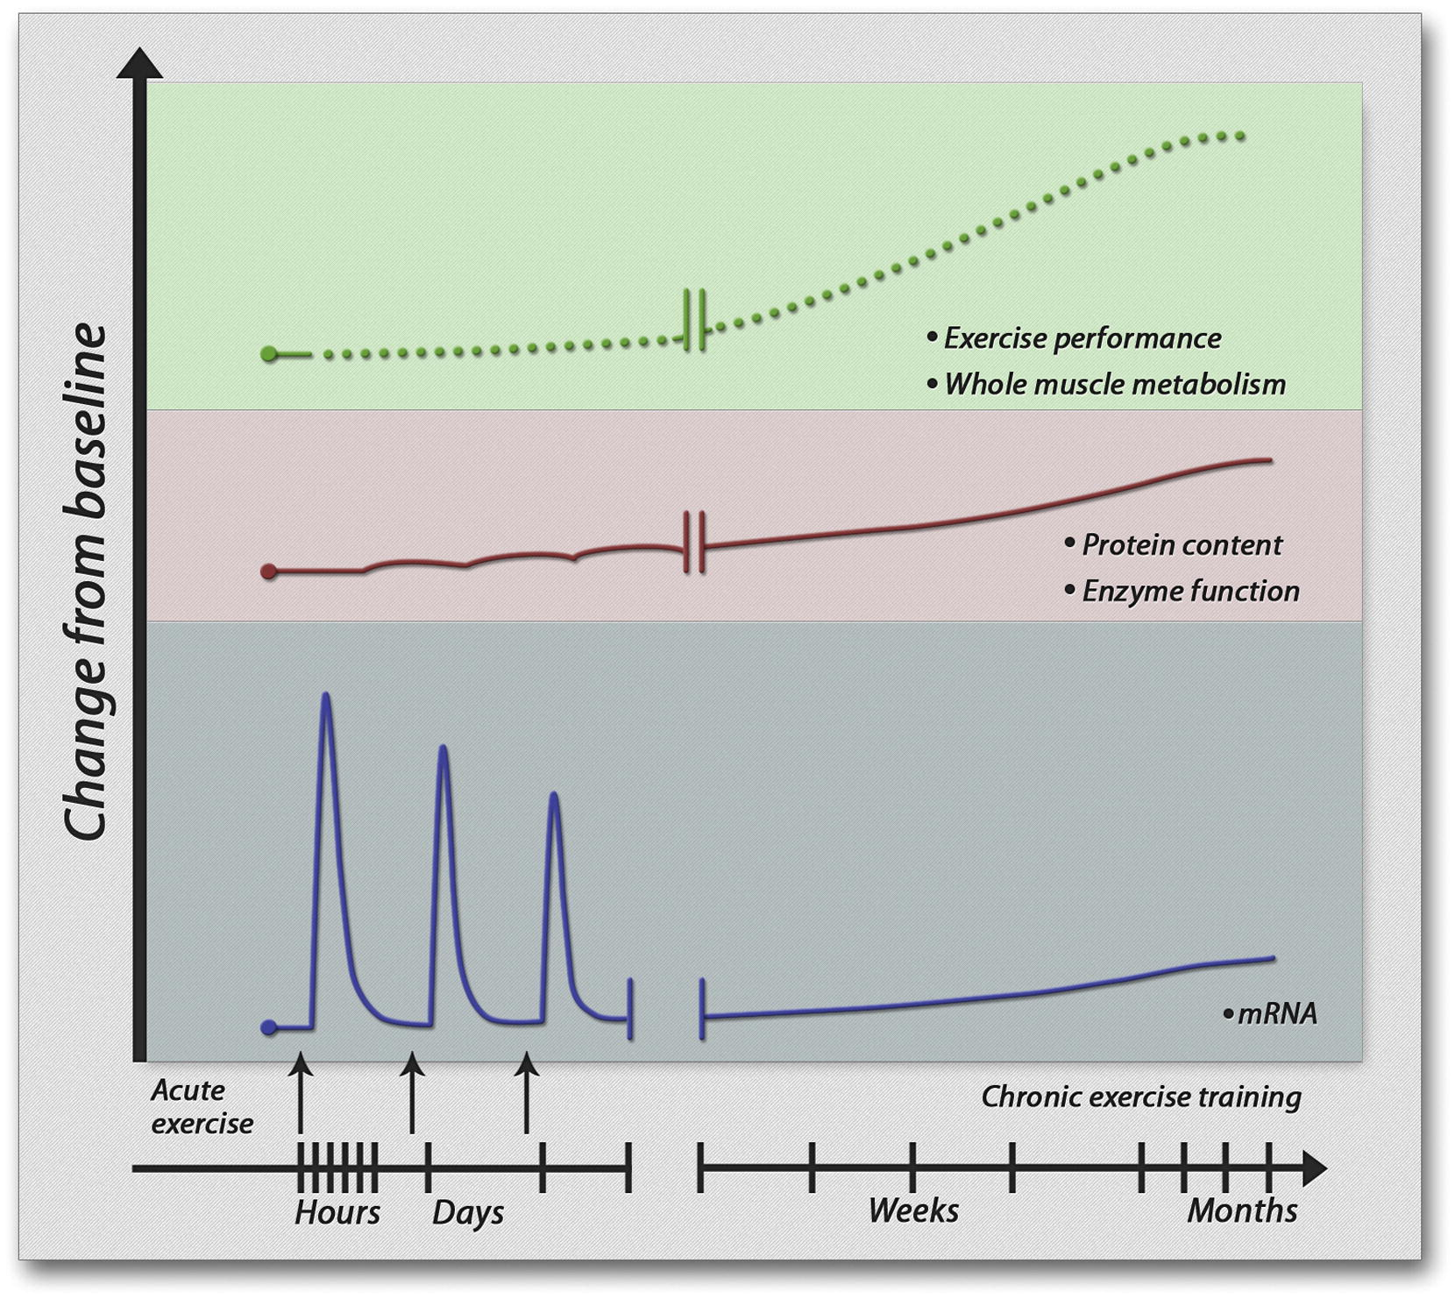
‘No pain No gain’ We can’t change our genes but can improve the accessibility of the genome leading to improved resilience
The molecular basis of adaptation to ‘stress’ challenges (here for exercise-related training)
Improved skeletal muscle phenotypes after resistance-type exercise in healthy & frail older subjects
Hangelbroek R, Fazelzadeh P, Tieland T, Boekschoten M, Hooiveld G, van Duynhoven J, Timmons J, Verdijk L, de Groot L, van Loon L, Müller M . Expression of protocadherin gamma in skeletal muscle tissue is associated with age and muscle weakness. J. Cachexia, Sarcopenia & Muscle 2016
Notes:
Heatmap of 184 genes that are significantly different between young and old, and are significantly changed by resistance-type exercise

Slide 11
What do we know about the mechanisms? Healthy food (pattern)s have a large impact on our gene expression & phenotype
(Micro & Macro) Nutrients
High in Mono & (N-3) polyunsaturated fatty acids
Sufficient high-quality protein (optimal macro-nutrient ratio)
Vitamins (e.g. vitamin A & D) , minerals (e.g. Zn)
Microbiota (from foods)
Vegetarians / omnivores / carnivores => different microbiota
“Raw” or fermented food (e.g. diary, cheese) consumption => food-borne microbiota
Dietary diversity => microbiota diversity & genetic richness
Plant food components
Fibers or secondary plant metabolites (e.g. resveratrol, glucosinolates) e.g. bitter => “healthy stressors” & impact on microbiota
Less foods/calories & diet-related stress (caloric restriction)
“Chromatin exercise” & other epigenetic mechanisms
“Cell exercise” (e.g. via autophagy)

Slide 12

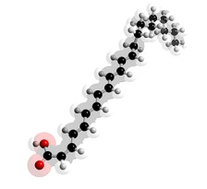
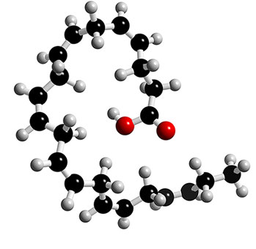
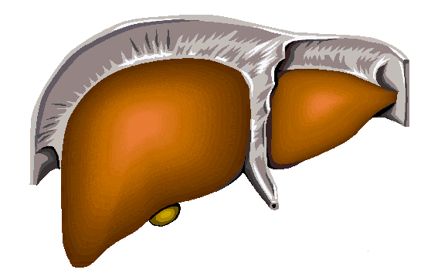
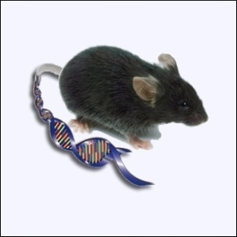




Understanding Nutrition How nutrients fine-tune the use of our genome potential
Changed organ metabolic capacity

Slide 13

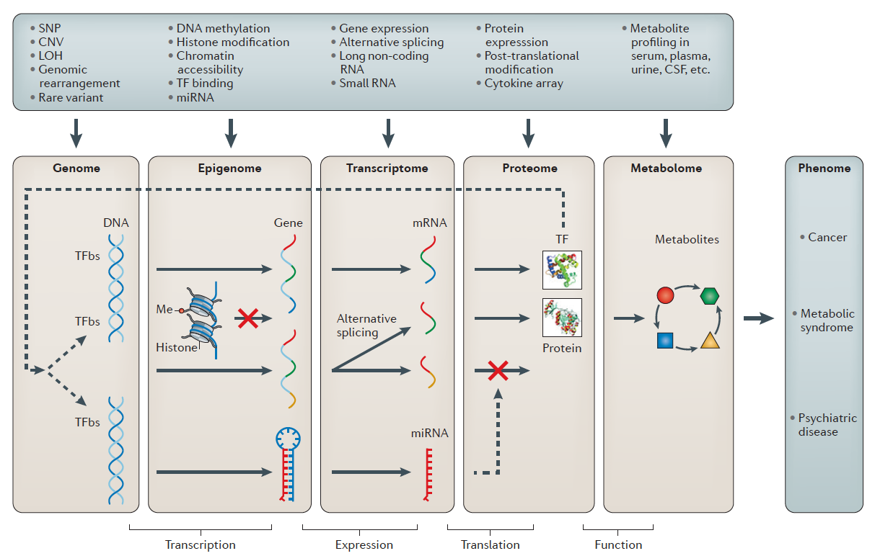
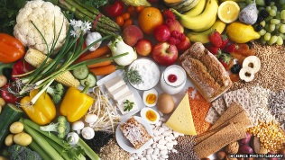

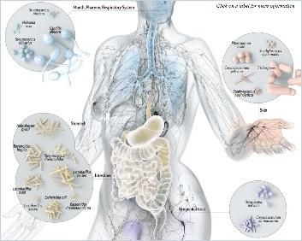
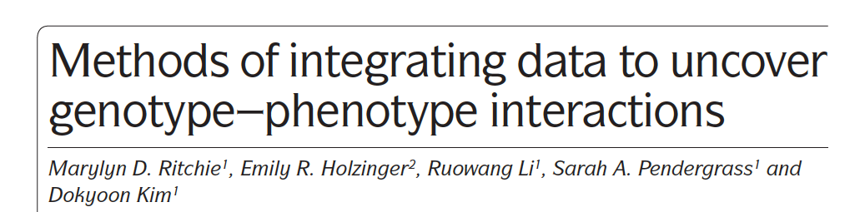
Biological systems multi-omics
Phenome
Metabolic Syndrome CVD NAFLD
Inflammatory Diseases
Prostate Cancer
Nature Reviews Genetics 2015

Slide 14
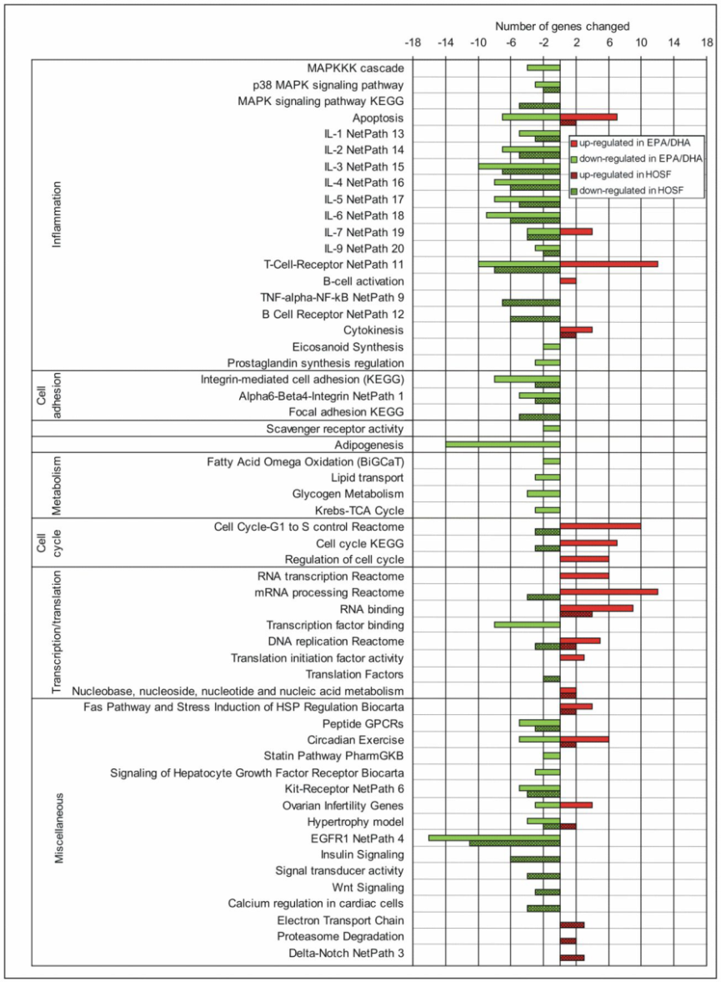

Fish-oil supplementation leads to anti-inflammatory gene expression profiles in human blood mononuclear cells
Less inflammation & decreased pro-arteriosclerosis markers = Anti-immuno-senescence
Bouwens et al. Am J Clin Nutr. 2009

Slide 15
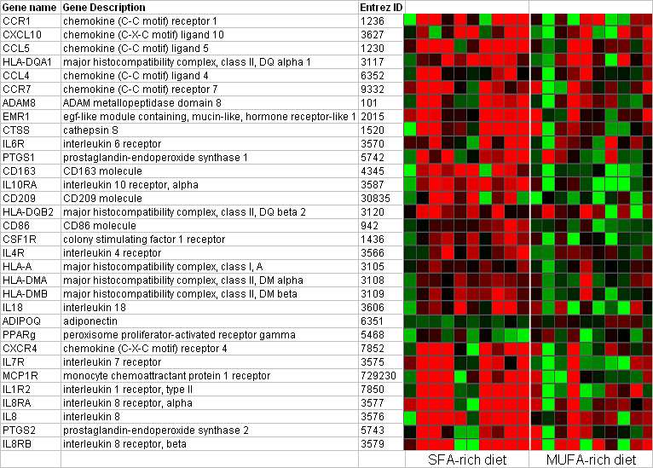
‘Obese-linked’ pro-inflammatory gene expression profile by SFAs
SFA diet
MUFA diet
The SFA-rich diet:
Induces a pro-inflammatory obese-linked gene expression profile
Decreases expression and plasma level of the anti-inflammatory cytokine adiponectin
“Personal Transcriptomes”
Van Dijk et al. AJCN 2009

Slide 16
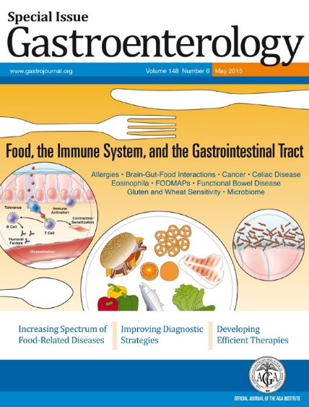
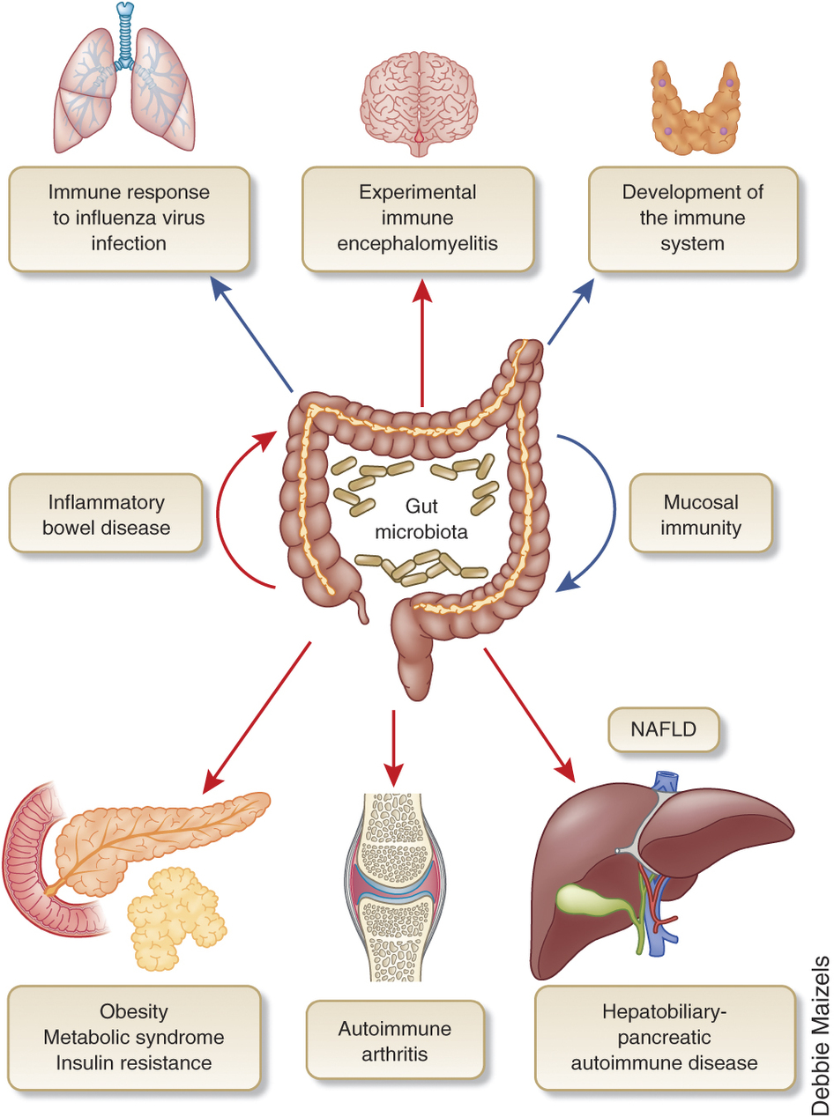
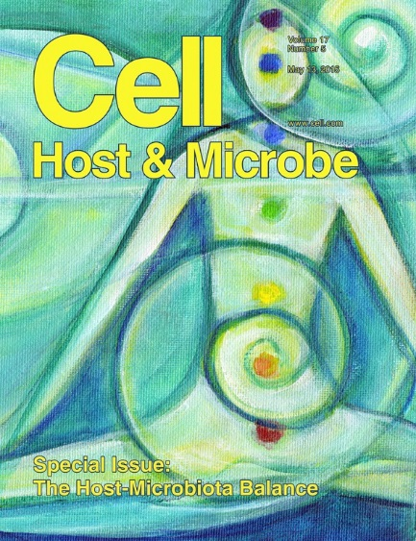
From local problems to systemic diseases – the contribution of the gut (microbiome)

Slide 17
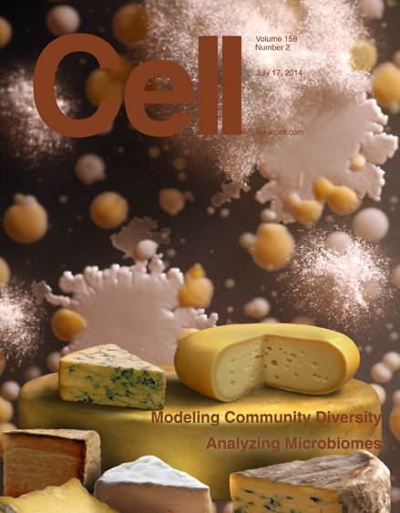

Feed your gut (microbiome)

Slide 18
Mechanisms of signaling from the gut microbiota to the host
Sonnenburg JL, Bäckhed F. Diet-microbiota interactions as moderators of human metabolism. Nature. 2016 Jul 6;535(7610):56-64.
Notes:
Figure 2 . The gut microbiota interacts with dietary components and metabolites to form bioactive metabolites that signal to the host through distinct mechanisms. Short-chain fatty acids that are produced by the fermentation of fibre are an important source of energy (ATP) for colonocytes. They are also a substrate for gluconeogenesis, which modulates central metabolism, and are involved in signalling to the host by inhibiting histone deacetylase (HDAC) or by activating G-protein-coupled receptors such as GPR41 and GPR43, which triggers the release of the hormone glucagon-like peptide-1. The primary bile acids cholic acid (CA) and chenodeoxycholic acid (CDCA) are metabolized into the secondary bile acids deoxycholic acid (DCA) and lithocholic acid (LCA), which activates signalling to the host through the G-protein-coupled bile acid receptor 1 (GPBAR1; also known as TGR5). Tauro-β-muricholic acid (TβMCA) is deconjugated into β-muricholic acid (βMCA; not shown), which alleviates the inhibition of the farnesoid X-activated receptor (FXR; also known as the bile acid receptor) by TβMCA. Microbially produced endotoxins (also known as lipopolysaccharides) are taken up into chylomicrons that are formed from dietary saturated fats and subsequently they promote inflammation in the host that induces insulin resistance. l-Carnitine and choline, compounds that are found in red meat, are metabolized into TMAs that are oxidized further into TMAO by the enzyme flavin-containing monooxygenase 3 (FMO3) in the liver (inset).

Slide 19
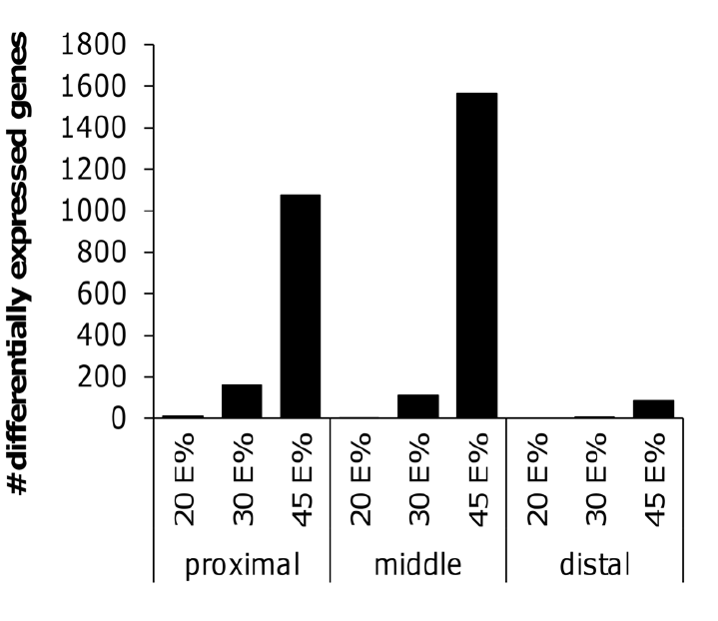
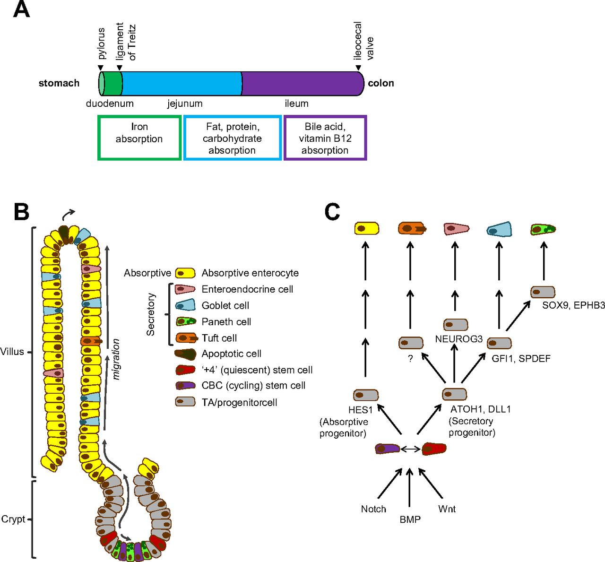
Adaptive response to a switch from high starch to high sat. fat diet in the mouse small intestine
De Wit et al Plos ONE 2011

Slide 20

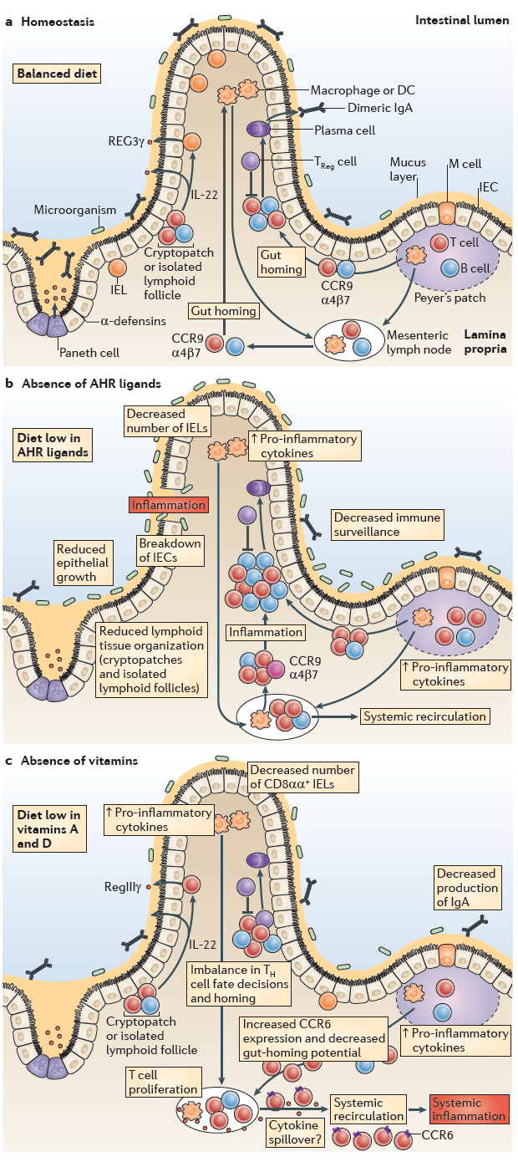

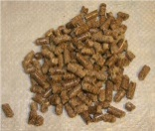
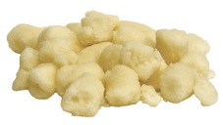
Different diets induce different gut phenotypes
Dietary impact on the activation of the AhR essential for the gut immune system
3 Diets =
3 functional states
of the gut

Slide 21
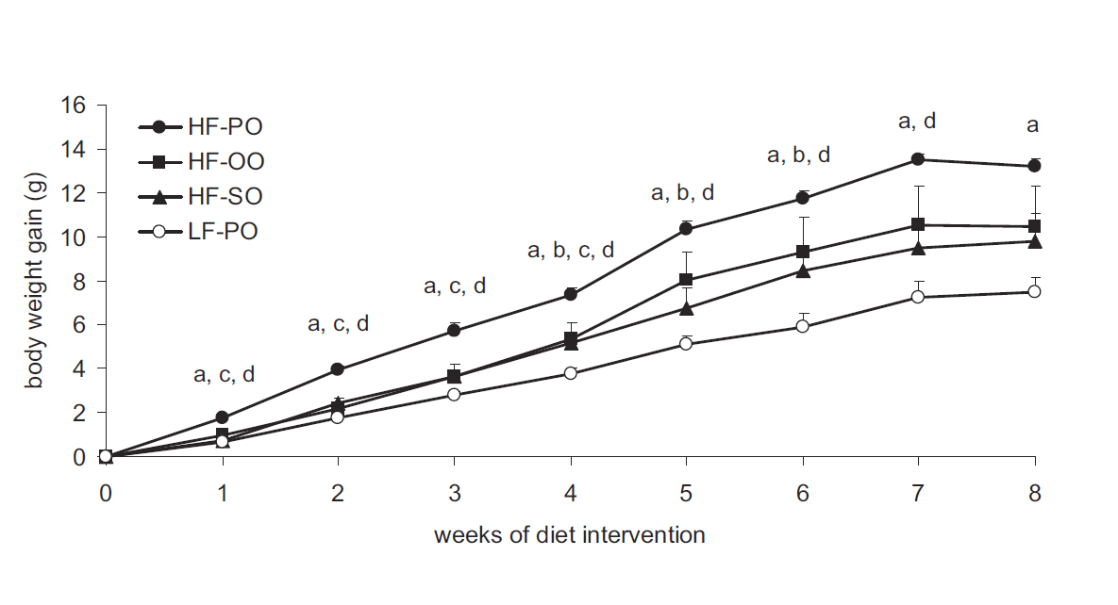
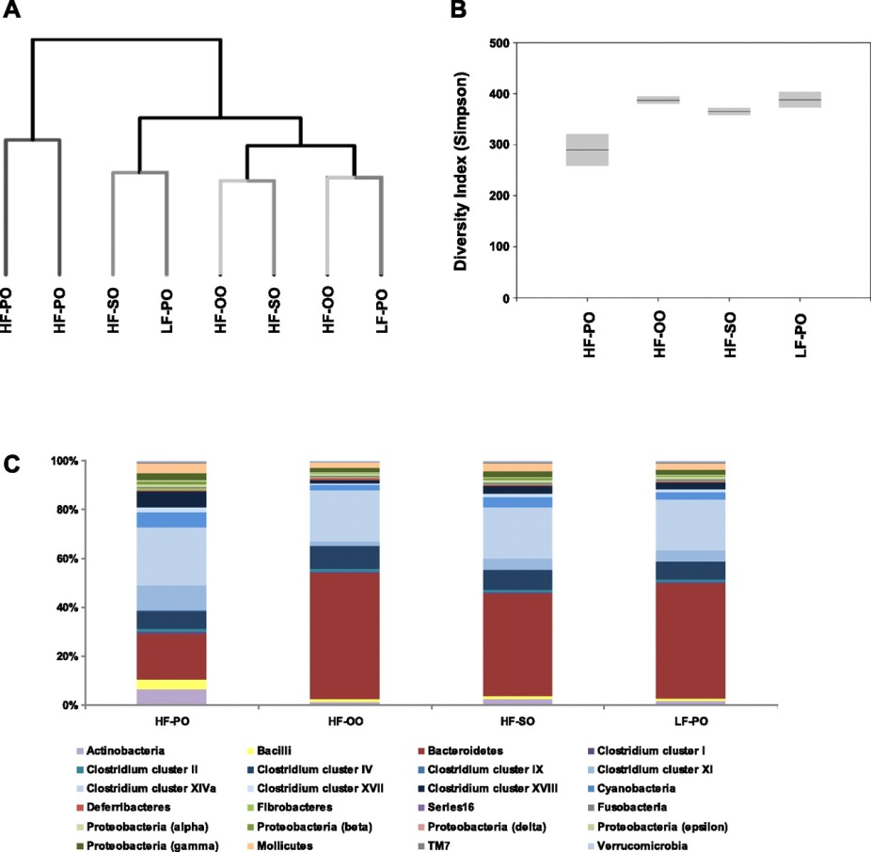
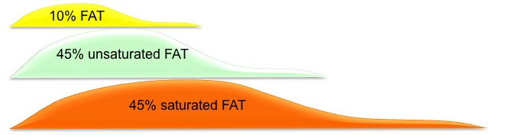
High sat. fat diets induce obesity & development of NAFLD => enhanced overflow of dietary sat. fat to the ileum and remodelling of gut microbiota
Oils
Palm
Olive
Safflower
Palm
A high-sat. fat-diet reduced microbial diversity and increased the Firmicutes-to-Bacteroidetes ratio
Am J Physiol Gastrointest Liver Physiol. 2012;303:G589-99

Slide 22
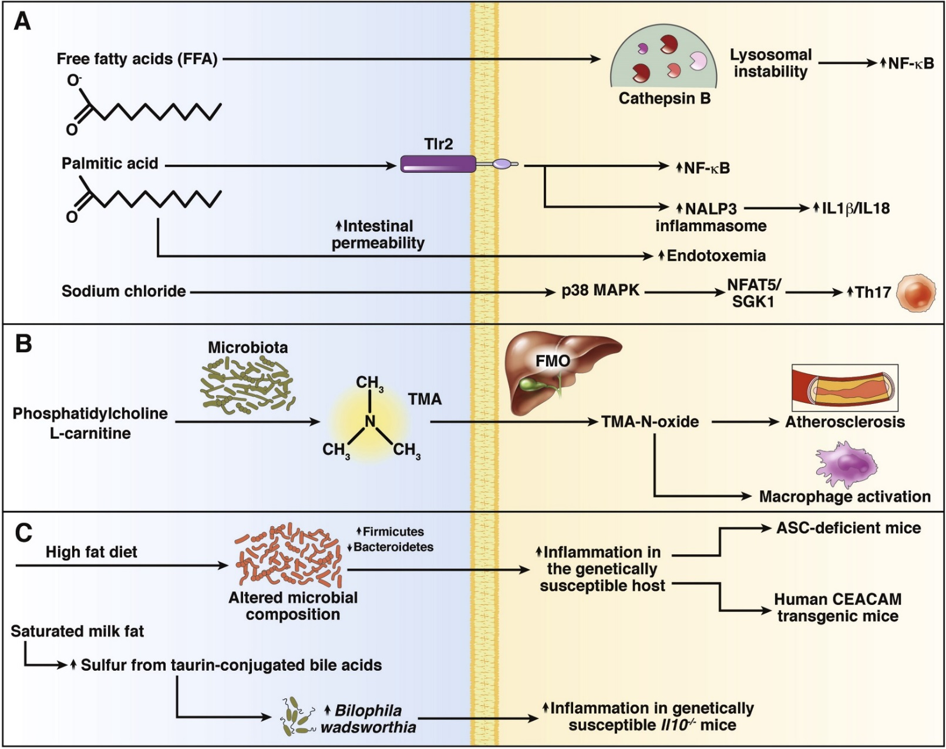

Inflammatory mechanisms of food components
Tilg H, Moschen AR. Food, immunity, and the microbiome Gastroenterology. 2015 May;148(6):1107-19.
Notes:
Inflammatory mechanisms of food components. (A) Certain dietary components can activate inflammatory pathways directly. Free fatty acids (FFA) induce lysosomal instability, leading to release of cathepsin B and activation of nuclear factor-κB (NF-κB). Palmitic acid activates IL1β and IL18 through a pathway involving Tlr2 and the NALP3 inflammasome. Palmitic acid also increases intestinal permeability, resulting in endotoxemia in the portal and systemic circulation. Sodium chloride enhances differentiation of IL17-producing CD4+ T cells (T-helper 17 cells) through a pathway involving p38 MAPK, NFAT5, and SGK1. (B) Other dietary components induce inflammation indirectly, after modification by the commensal microflora. Ingested PC or L-carnitine is converted to TMA by bacterial enzymes. TMA is processed further by hepatic flavin monooxygenases to TMAO, which promotes atherosclerosis and activates macrophages. (C) Certain diets alter the intestinal microbiota to one that promotes inflammation. In genetically susceptible animals (those with defects in inflammasome function or animals that overexpress carcinoembryonic antigen–related cell adhesion molecules [CEACAMs]), these alterations to the microbiota can promote initiation or aggravation of intestinal inflammation, via various mechanisms. Milk-derived saturated fats promote taurin-conjugation of bile acids—important sources of organic sulfur, supporting the development of sulfite-reducing pathobionts such as B wadsworthia. These can promote inflammation. ASC, apoptosis-associated speck-like protein containing a CARD; FMO, flavin monooxygenases; NALP3, NOD-like receptor family, pyrin domain containing 3; NFAT5, nuclear factor of activated T cells 5; SGK1, serine/threonine-protein kinase 1; Th, T helper cell.

Slide 23
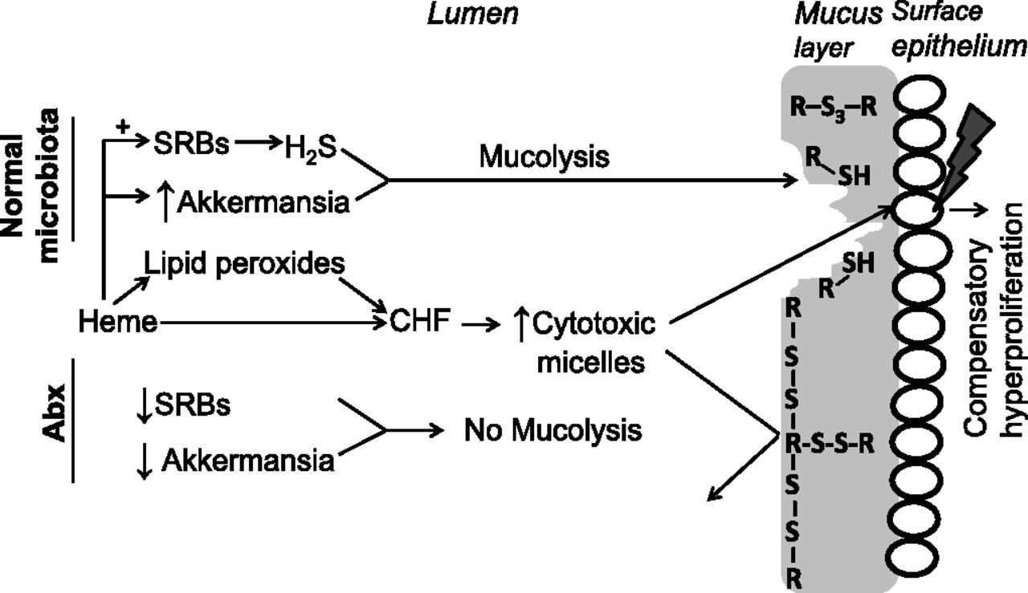
Context is important How microbiota may facilitate heme-induced compensatory hyperproliferation in the colon
Noortje Ijssennagger et al. PNAS 2015;112:10038-10043
Notes:
Proposed mechanism of how microbiota facilitates heme-induced compensatory hyperproliferation. (Upper) Processes when normal microbiota is present (i.e., without Abx) leading to compensatory hyperproliferation. (Lower) How Abx cause the mucus layer to be protective against cytotoxic micelles. R-S-S-R indicates native intra- and intermolecular disulfide bonds in the mucus that can be reduced by H₂S to thiols (R-S-H) and trisulfides (R-S-S-S-R).

Slide 24
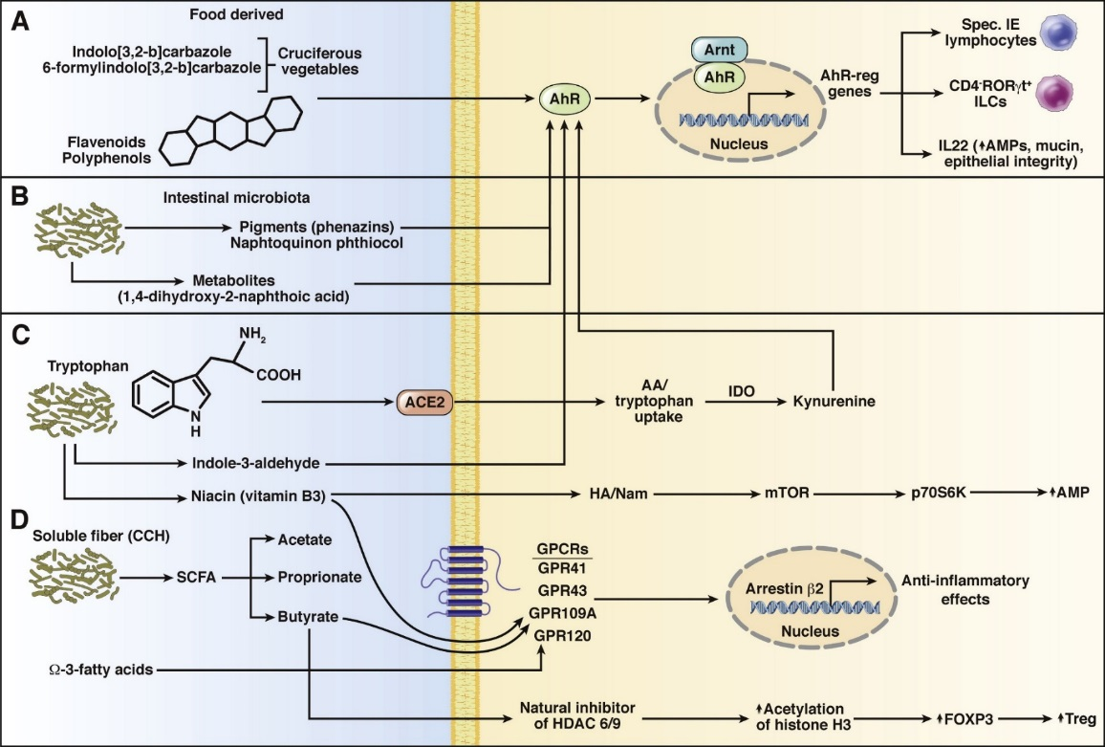

Anti-inflammatory effects of plant food components
Tilg H, Moschen AR. Food, immunity, and the microbiome Gastroenterology. 2015 May;148(6):1107-19.
Notes:
Anti-inflammatory effects of food components. (A) AhR provides an important link between the intestinal immune system and food-derived ligands. AhR activating ligands include indolo(3,2-b) carbazole or 6-formylindolo(3,2-b) carbazole, which come from cruciferous vegetables, flavonoids, and polyphenols, (B) as well as bacterial-derived molecules, such as phenazins and naphtoquinon phthiocol, and microbial metabolic products such as 1,4-dihydroxy-2-naphthoic acid. AhR ligands activate chaperone-bound AhRs, which dimerize with the AhR nuclear translocator (Arnt) to regulate gene expression. AhR signaling is required for the generation and maintenance of intestinal immune cells including specialized intraepithelial lymphocytes and CD4-RORγδ+ innate lymphoid cells. AhR-induced production of IL22 could have immunomodulatory and metabolic effects. (C) Tryptophan is another important anti-inflammatory molecule in food. Its uptake is regulated by intestinal ACE2 (independent of its functions in the renin-angiotensin system). Tryptophan is converted to indole-3-aldehyde (another ligand of AhR) by bacterial enzymes. Tryptophan is required for the generation of nicotinamide (also vitamin B3 or niacin). Nicotinamide can activate the mTOR pathway, including p70S6 kinase and antimicrobial peptides, to produce anti-inflammatory effects. Within the cell, tryptophan is converted to kynurenine (another AhR ligand) by indoleamine 2,3-dioxygenase (IDO). (D) Soluble dietary fiber (complex carbohydrates, CCH) is cleaved into SCFAs by bacterial glycoside hydrolases. The SCFAs acetate, proprionate, and butyrate have anti-inflammatory effects. SCFAs bind GPCRs such as GPR41, GPR43, or GPR109A, which activate the transcription factor arrestin-β2. Interestingly, GPCRs can be activated by other ligands such as niacin (GPR109A) and Ω-3 fatty acids (GPR120). Butyrate is a natural inhibitor of the histone deacetylases 6 and 9, and could promote development of peripheral regulatory T cells through epigenetic mechanisms. AA, amino acids; FOXP3, forkhead box P3; HA/Nam, nicotinamide; IE, intraepithelial; ILCs, intestinal lymphoid cells; mTOR, mechanistic target of rapamycin; Treg, regulatory T cells.

Slide 25
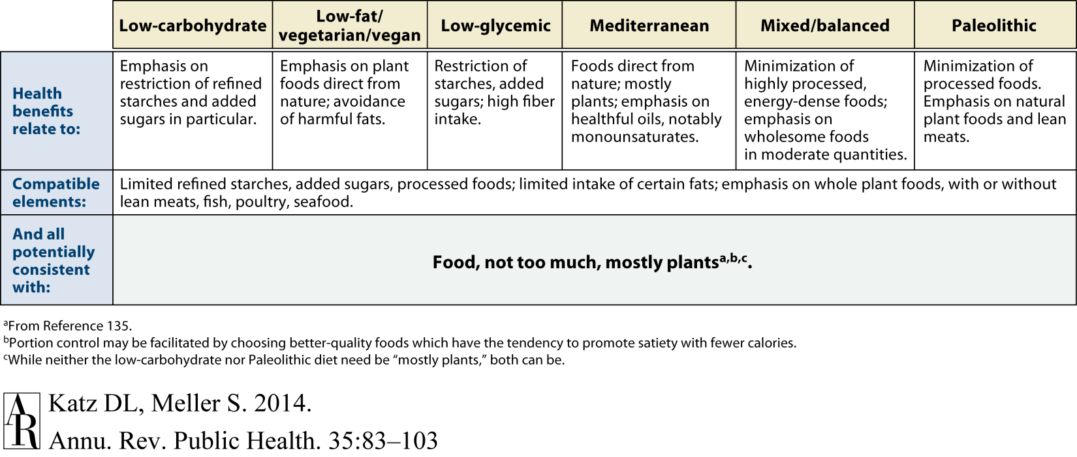
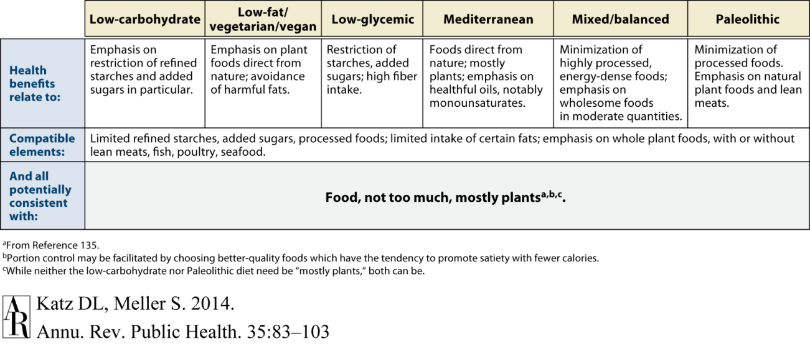
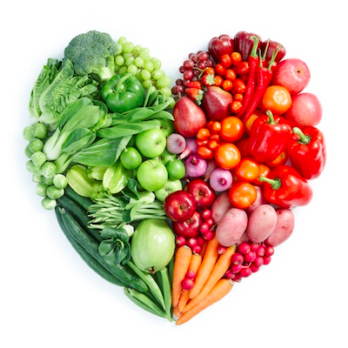
What is a healthy diet? "Eat food, not too much, mostly plants"
Michael Pollan, The Omnivore's Dilemma

Slide 26
Resistant starch leads to changes in the microbiome & related host responses in the proximal colon of male pigs
Consumption of resistant starch (RS) has been associated with various intestinal health benefits, but knowledge of its effects on global gene expression in the colon is limited.
Ten 17-wk-old male pigs (Landrace barrows), fitted with a cannula in the proximal colon for repeated collection of tissue biopsy samples and luminal content, were fed a digestible starch (DS) diet or a diet high in RS (34%) for 2 consecutive periods of 14 d in a crossover design.
.
Haenen et al. J. Nutr. 143: 274-293 & 1889–1898, 2013

Slide 27
Resistant starch in pigs: Increased bacteroidetes & plasma SCFAs
The abundance of the phyla Bacteroidetes and Firmicutes in pigs fed DS or RS for 2 wk
Acetate, propionate, and butyrate concentrations in peripheral plasma
Haenen et al. J. Nutr. 143: 274-293 & 1889–1898, 2013
Notes:
The abundance of the phyla Bacteroidetes and Firmicutes (A) and the ratio Firmicutes/Bacteroidetes (B) in pigs fed DS or RS for 2 wk, as determined by PITChip. Data are presented as means ± SEM, n = 9 per treatment. * indicates P < 0.05. DS, digestible starch; RS, resistant starch.

Slide 28
Effects of resistant starch on colonic gene expression positively enriched gene sets (TCA cycle or lipid metabolism) negatively enriched gene sets (adaptive or innate immune response)
Notes:
High resolution color enrichment map for effects of resistant starch on colonic gene expression. The map displays the enriched gene-sets in proximal colon after 2 wk consumption of the RS diet compared to 2 wk consumption of the DS diet. Nodes represent functional gene sets, and edges between nodes their similarity. Red node color indicates enrichment after RS consumption (i.e. induction after RS feeding), whereas blue represents enrichment after DS consumption (i.e. reduction after RS feeding). Node size represents the gene set size, and edge thickness represents the degree of overlap between 2 connected gene sets. Clusters are manually grouped and labeled to highlight the prevalent biological functions among related gene sets. The abbreviation before the name of the gene set indicates the database the gene set was derived from: no abbreviation: Gene Ontology; KEGG: Kyoto Encyclopedia of Genes and Genomes; BIOC: Biocarta; REACT: NCI: National Cancer Institute; Reactome, WiP: WikiPathways, PFAM: protein family.
Heatmap of significantly regulated genes (P <0.05) present in the positively enriched gene sets describing TCA cycle or lipid metabolism, or present in the negatively enriched gene sets describing processes involved in adaptive or innate immune response. Mean and individual log2 fold changes are presented. The intensity of the red and green color indicates the degree of induction or suppression per pig, respectively, and ranged from -0.65 (green) to 0.65 (red). Pigs are ranked based on their identifier. The vertical color bars indicate gene set membership; dark blue: TCA cycle, light blue: lipid metabolism, olive green: adaptive immune response, tan: innate immune response.

Slide 29
Resistant starch induces catabolic but suppresses immune and cell division pathways and changes the microbiome in the proximal colon of male pigs
The nuclear receptor peroxisome proliferator-activated receptor γ was identified as a potential key upstream regulator.
Increased relative abundance of several butyrate-producing microbial groups, including the butyrate producers Faecalibacterium prausnitzii and Megasphaera elsdenii, and reduced the abundance of potentially pathogenic members of the genus Leptospira and the phylum Proteobacteria.
Concentrations in carotid plasma of the 3 main short-chain fatty acids acetate, propionate, and butyrate were significantly higher with RS consumption compared with DS consumption.
.
Haenen et al. J. Nutr. 143: 274-293 & 1889–1898, 2013

Slide 30
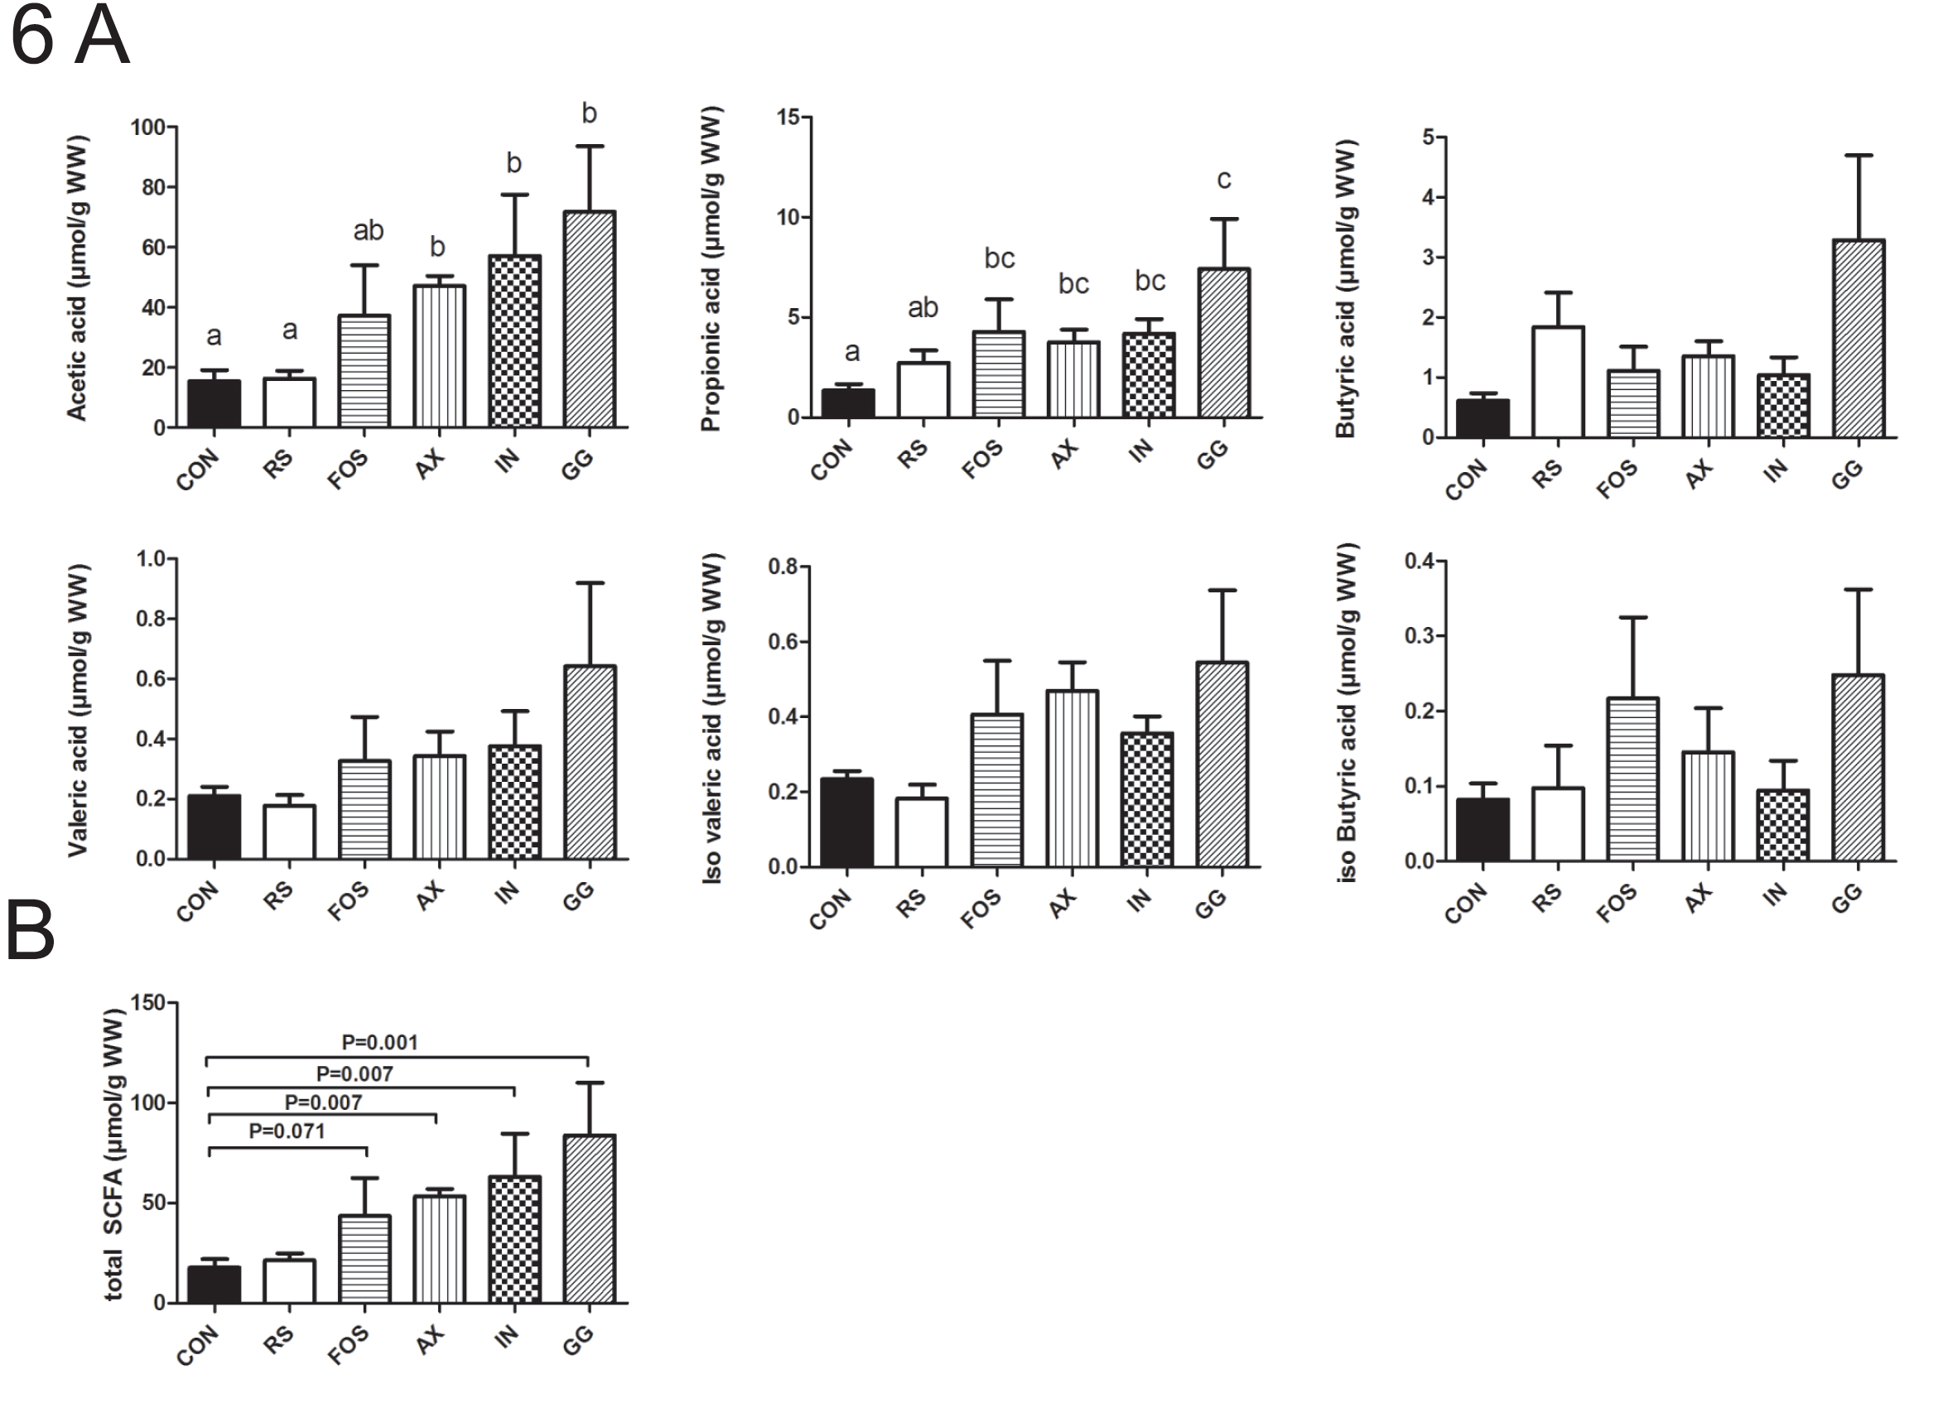
Role of dietary fibres on gut function in mice
INULIN, FOS, GuarGum, NAXUS (Arabinoxylan), Resistant Starch, Control = Starch
10 days
microbiota
SCFA
Mol Nutr Food Res. 2015, 59,1590–1602.

Slide 31
Integration of epithelial cell gene expression with luminal microbiota composition
Bacterial groups within Clostridium cluster XIVa positively correlated with genes involved in energy metabolism (1)
Mol Nutr Food Res. 2015, 59,1590–1602.

Slide 32
Biological processes regulated by dietary fibers
Mol Nutr Food Res. 2015, 59,1590–1602.

Slide 33
Pparγ targets
Role of Pparγ in fibre-dependent gene regulation
Fibre-specific effects on Pparγ transcriptome
Upstream regulator
Mol Nutr Food Res. 2015, 59,1590–1602.
Notes:
Identification of upstream regulators
The underlying mechanisms by which the fibers modulated gene expression changes are not well understood. We therefore aimed to identify potential upstream transcriptional regulators that could explain the observed shifts in gene expression profiles. Next to the canonical involvement of PPAR, the different diets appear to modulate gene sets that are connected to other regulators (Table 1).In line with results obtained by GSEA, PPAR, particularly the isoform PPARG, was potentially activated for FOS, AX, GG, but most for IN. In addition, we observed both overlapping and unique sets of PPARG target genes within the fiber specific GS (Supplemental Fig. 1). Next to PPARG, several other regulators were predicted to play a role in the transcriptional responses elicited by one or more of the fiber diets. Notably, the transcription regulator KDM5B was uniquely predicted to play a role in control of the RS modulated gene expression profiles, which may at least in part explain the specific gene expression profile induced by RS. KDM5B plays a role in cell fate decisions. In addition, within the FOS-specific transcription pattern changes, NR5A2 and MBD2 were uniquely predicted to play a role in the control of these genes. Among the transcriptional regulator for GG diets we identified sterol/lipid metabolism related regulator (SREBF1, SREBF2) and NR1I2 involved in drug metabolism. Taken together, we identified potential transcription regulators that may explain commonalities and differences in gene regulation patterns observed for the different fiber diets. In particular, PPARG is a potential important regulator involved in the gene expression response to dietary fiber in colonic epithelia.

Slide 34
Interactions between the diet & the gut microbiota dictate the production of short-chain fatty acids
Sonnenburg JL, Bäckhed F. Diet-microbiota interactions as moderators of human metabolism. Nature. 2016 Jul 6;535(7610):56-64.
Notes:
Figure 1 . Dietary fibre is a source of complex carbohydrates, which are required for the production of short-chain fatty acids such as acetate, butyrate and propionate. When the diversity of the microbiota is high and the diet contains many types of complex carbohydrates (top right), a relatively high percentage of complex carbohydrates will be accessible to the microbiota. But when the diversity of the microbiota is low and the diet contains many types of complex carbohydrates (left), only a low percentage of these complex carbohydrates are accessible to the microbiota. If the fibre composition of the diet is matched to the needs of a low-diversity microbiota (bottom right) by limiting the types of complex carbohydrate that are available, the levels of production of certain short-chain fatty acids, such as propionate, might increase. However, the diversity of the microbiota will probably remain low and it might not be able to provide as many functions as a diverse microbiota. Consumption of a complex diet (top right) might result in increased levels of production of multiple types of short-chain fatty acids and helps to recruit additional diversity to the gut microbiota. The level of propionate production is correlated with the abundance of Bacteroides species in the gut, which is consistent with the involvement of these bacteria in the production of propionate125. Fermentation of fibre in the colon has been shown to decrease pH levels, which can help to increase the diversity of the gut microbiota or results in the reinforcement by certain taxa of a pH that favours their own growth126–129.

Slide 35
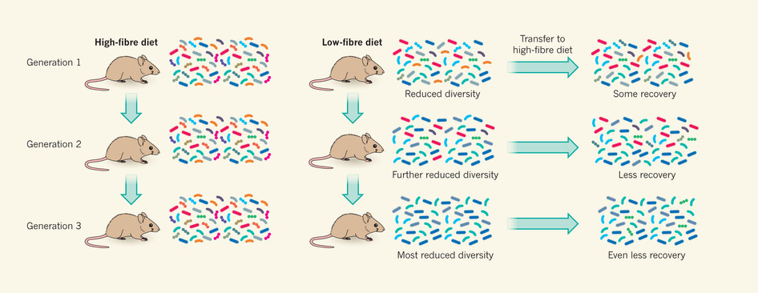
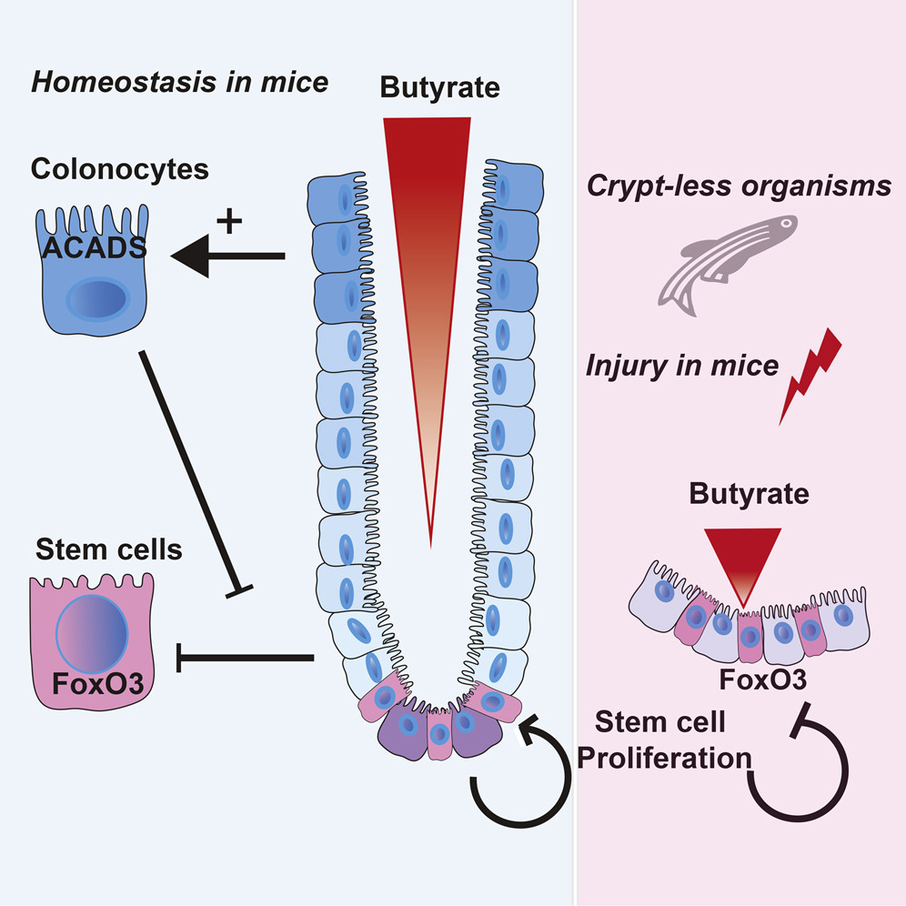
Role of dietary fibres in the colon
Differential regulation of genes involved in metabolic, energy-generating and oxidative processes & those involved in adhesion dynamics and signalling by dietary fibres (MNFR 2015).
Strongly linked to Clostridium cluster XIVa bacteria (butyrate producers) & likely governed by the transcription factor PPARγ (MCB 2013; & data with organoids from gut-specific Pparγ-k.o. mice).
Because of different fermentation behaviour fibres will have a diverse location-specific impact on the microbiome and the host immune-metabolic responses.
Not ‘one fibre fits all’: Diverse food patterns (rich in plant foods) are recommended to keep our guts ‘flexible and healthy’!

Slide 36
The most powerful trigger next to exercise is ‘eating less’
Weight Gain
Survival

Slide 37
Diets and aging strongly impact the intestine & its microbiota (here colon)

Slide 38
Aging and different energy intake have a strong impact on colonic microbiota

Slide 39
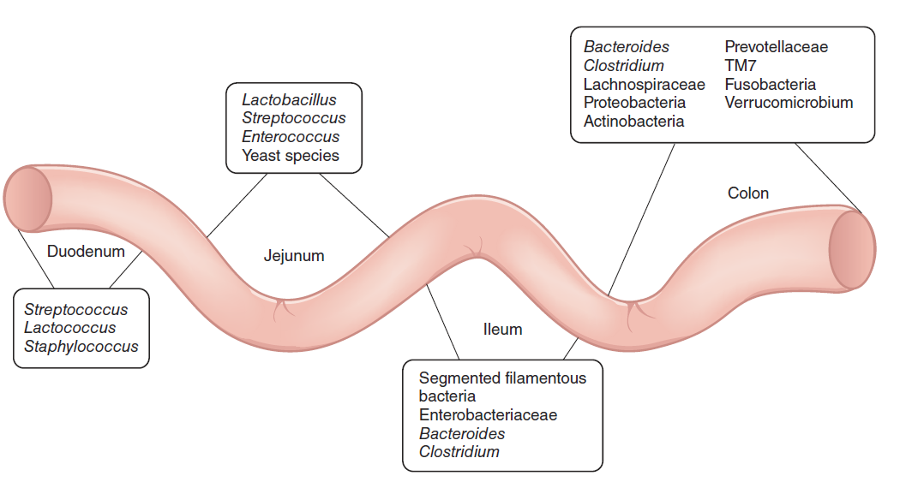

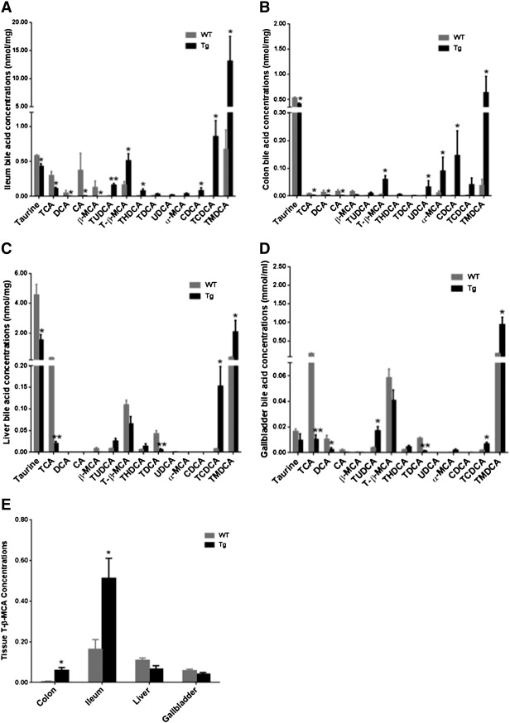
We have to understand better the molecular mechanisms of how gradients are sensed and how they regulate immune-metabolic capacity of the gut-liver axis
Nutrients
SCFAs
Bioactives
Microbiota
Metabolism
Immunity
Bile acids
Microbial Metabolism
Drugs
Unintended effects?

Slide 40
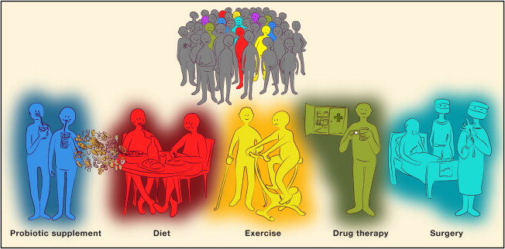
Future Perspective: Stratification and precision treatments Identification and personalized treatments of patients at risk for developing type 2 diabetes based on their microbiota
http://personalnutrition.org
Notes:
Subjects may be identified to be at risk to develop T2D based on their microbiome. Different microbiome compositions, together with classical clinical biomarkers, may potentially allow stratification to different treatments/preventions such as lifestyle interventions (yellow), specific diets and/or prebiotics (red), classical or novel probiotics (blue), a combination of diet and probiotic (purple), specific drugs (green), or bariatric surgery (blue).

Slide 41
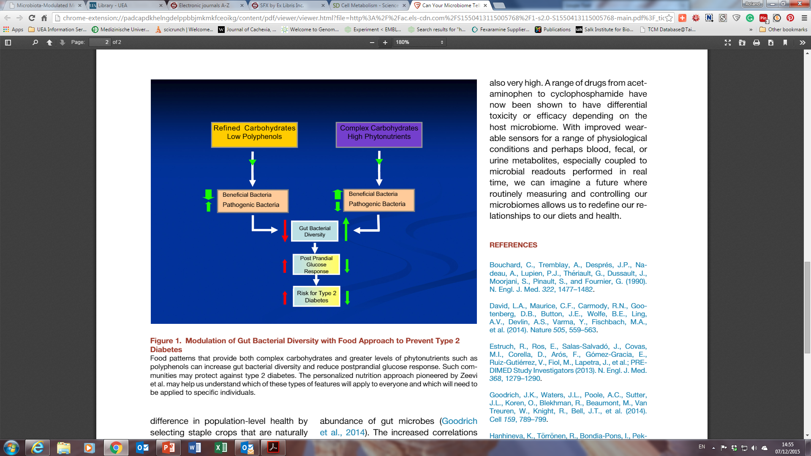

Modulation of gut bacterial diversity with a food approach to prevent type 2 diabetes

Slide 42
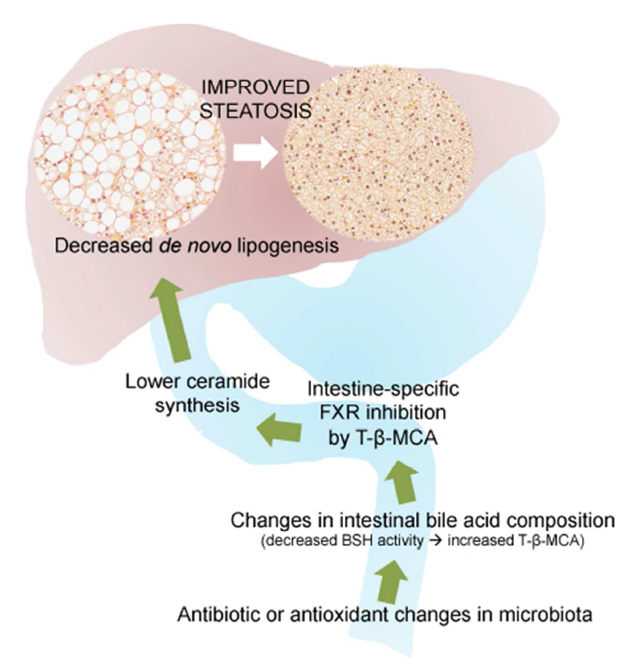
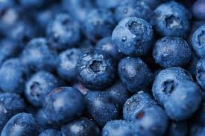

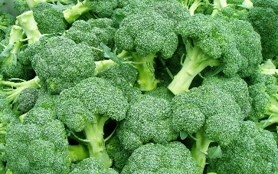
Target the gut to target the liver & improve metabolic health

Slide 43

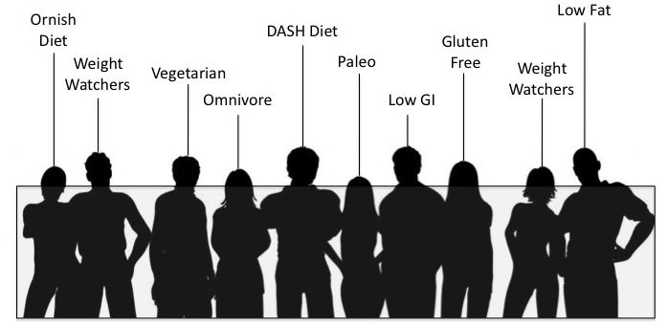






We are what we fed them…?
‘our gastrointestinal tract is not only the body's most under-appreciated organ, but "the brain's most important adviser”’.

Slide 44
Nutrigenomics enables us
To define the mechanistic framework of nutrition;
To stratify cohorts (patients, healthy volunteers) by using individual Omics-data (microbiome, metabolome, etc);
To quantify the nutritional needs for optimized fitness at different life stages;
To improve early diagnostics of nutrition related disorders (“challenge tests”);
To support the development of “smart healthy food patterns” for modern mankind (healthy and tasty, sustainable, affordable);
To enable the transition of nutritional science to ‘nutritional science 2.0’.
Evidence-based systems nutrition
Precision nutrition
Personalized nutrition
Effective prevention strategies
Reformulation of foods
“Digital” nutrition 2.0

